Slide 1

DirecTV Project
C3 Replay & Startover
By Dung Tran Thi My
Nov 05th 2013

Slide 2

Agenda
DTV-US
1. Overview
2. Start Over feature
- How it works
- UI changes
- OSDs
3. C3 Replay
- How it works
- UI changes
- OSDs
4. Reference
5. Q & A

Slide 3
1. Overview
DTV-US
  C3 Replay & Startover is a service which allows customer to download and view content that have been broadcast within the previous 3 days based on the STB’s local time.
  C3 Replay & Startover will be limited to only certain channels and programs.
  C3 Replay & Startover feature is available to DRVs when:
    Authorized for DVR Service, and
    HD capable (HR2x, R2x, HR3x, HR44), and
    Broadband connected

Slide 4
Start Over Feature
Confidential

Slide 5
2. Startover feature – How it works
DTV-US
  Startover allows user to start currently airing event from the beginning.
  Startover content is available for download between an event’s broadcast start time and broadcast end time, and not show up in user’s Playlist.
  Expire at broadcast end time if the event is not being used, or at the earliest of viewing end if the event is being used.
  Be deleted when the last viewer (in case there are multiple clients watching the same Start Over content) tunes away, finished watching, or the expiration time has reached.

Slide 6
2. Startover feature – How it works
DTV-US
  Can’t be recorded.
  Can’t be fast forwarded.
  STB will pause the current download (but not streaming) to download the Startover content.
  STB will remove existing records in user’s partition (Playlist) to store the Startover content when not enough space. If all records are marked as keep, STB will display OSD.

Slide 7
2. Startover feature – UI Changes
DTV-US
UI changes for Startover include:
- Guide grid,
- Channel Info screen,
- Program Info

Slide 8
2. Startover feature – UI Changes
DTV-US
Startover indicator is displayed on Guide grid, Info screen, View Upcoming, Search result, … when all the following are true:
- The SO (Schedule Object) indicates that this is a Startover candidate.
- Broadband connected.
- Current time is before the broadcast end time, and greater than
broadcast start time + Startover offset (the amount of time STB should wait
(head end processing time)).

Slide 9
2. Startover feature – UI Changes
DTV-US
Startover content is offered when all the following are true:
- User tunes to a program with Startover indicator, or rewinds on a
startover candidate to the beginning
- The channel is subscribed
- The program is not blacked out
- Current time is before the broadcast end time

Slide 10
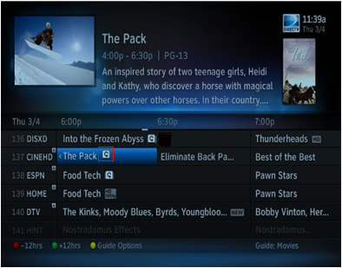
2. Startover feature – UI Changes
DTV-US
Changes in Guide grid:
- Startover icon is displayed on airing programs that have Startover rights
STB tunes to channel displays Startover OSD when SELECT on a startover eligible program
- Recording icon will have priority over Startover icon (No StartOver icon if program is recording)
Startover icon takes priority over attribution icons

Slide 11
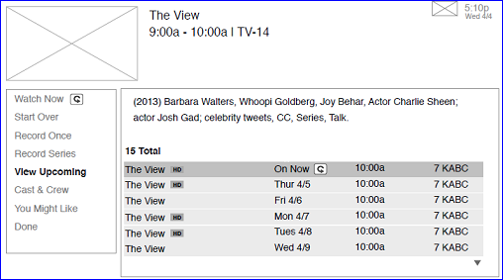
2. Startover feature – UI Changes
DTV-US
Changes in program Info screen (or Channel Info screen ):
Startover icon is displayed next to Watch Now left menu item and On Now in the result list
Select Watch Now that have Startover icon, STB tunes to program and display Startover OSD
- In result list, Starover icon is displayed with below format:
[start indicator icon] <ShowingTitle> [<scheduler icons> [<day>| S2871=On Now] [startover icon] <short time> <# ch num>

Slide 12
2. Startover feature – UI Changes
DTV-US
[start indicator icon] <ShowingTitle> [<scheduler icons> [<day>| S2871=On Now] [startover icon] <short time> <# ch num>
- On Now: is displayed when a program is currently airing
- <day>: is displayed when a program is NOT currently airing
- Scheduler icon: is displayed when an item has been set to record
- Startover icon: appears for currently airing programs that have Startover rights
- No Startover icon if scheduler icon is displayed (program is being recorded)

Slide 13

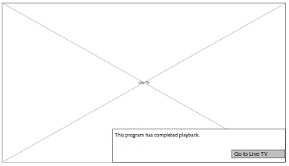
2. Startover feature – OSDs
DTV-US
Startover OSD: is displayed when the following are true:
- Program has Startover rights.
- Program has been airing for at
least X minutes.
- Program is not currently recording.
Startover - Complete OSD: is displayed when startover program completes playback

Slide 14
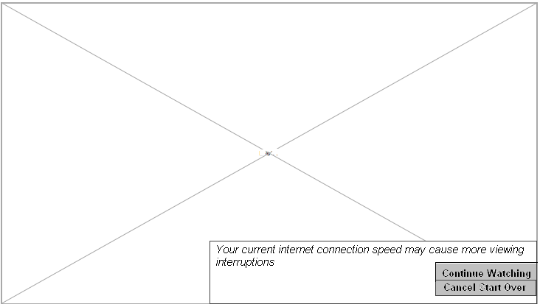
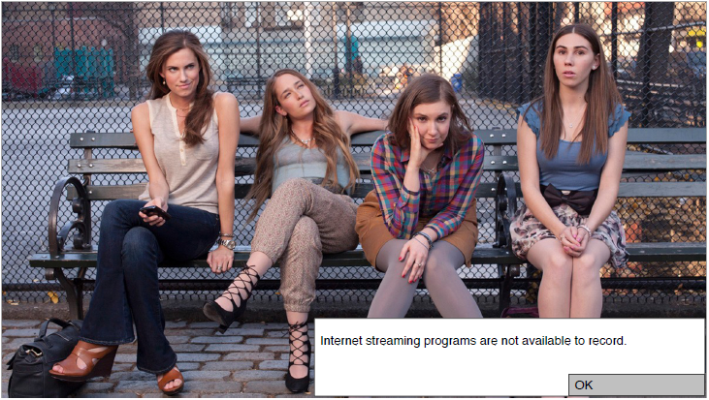
2. Startover feature – OSDs
DTV-US
Startover – Slow Connection OSD: is displayed each subsequent time buffering is encountered again during a session:
Startover – Record Disabled OSD: is displayed when pressing REC button during live playback of startover program

Slide 15
2. Startover feature – OSDs
DTV-US
Startover - Beginning of Buffer OSD:
- Be displayed when a user tunes to a currently airing program,
which has startover rights, but the user has not chosen to startover,
and they rewind to the beginning.
- OSD Text: “You cannot rewind further. Press <startover icon> to
stream program from the beginning”
- OSD button: None
Startover – Instant Play Conflict OSD:
- Be displayed when the broadband content can’t be played because the download resouce is in use
- OSD text: “This feature is unavailable because another program is
already downloading and playing”
- OSD button: Ok

Slide 16
C3 Replay Feature
Confidential

Slide 17
3. C3 Replay feature – How it works
DTV-US
  The head-end is responsible for listing titles or channels that have Replay category according to broadcast start time.
  C3 Replay contents are VOD titles available for download in homepages after currently events aired (after broadcast end time).
Show up in Playlist as Downloading, Pending Download, or Downloaded (similar to VOD).
Expire at 72 hours after broadcast end time.

Slide 18
3. C3 Replay feature – How it works
DTV-US
Can’t be fast forwarded
Is not converted to regular VOD contents
Replay titles are visible in:
- Playlist
- Channel INFO listings, Smart Search Results & View Upcoming
- Homepages
Replay titles are ignored by the Recommendation engine

Slide 19
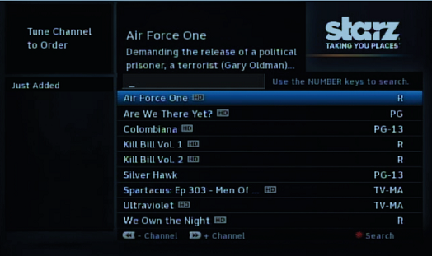
3. C3 Replay feature – UI Changes
DTV-US
Changes in Homepages:
C3 Replay titles are included in both
Type 1 and Type 2 homepages
(may be in ‘What’s On Now’, ‘Just
Added’ category)
C3 Replay titles are treated like any
other VOD programs (not have special
designation other than the short expiration date)

Slide 20
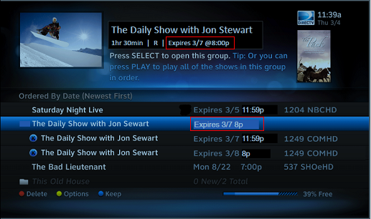
3. C3 Replay feature – UI Changes
DTV-US
Changes in Playlist:
- Playlist displays C3 Replay contents similar to regular VODs.
- Expiration date is displayed for all VOD playlist items

Slide 21
3. C3 Replay feature – UI Changes
DTV-US
Changes in Channel Info screen:
- STB will show C3 Replay titles in the results list if they are determined
to visible
- Sort order in the results list is:
+ C3 Replay titles ordered by broadcast start time, and then
+ Linear titles ordered by broadcast start time.

Slide 22
3. C3 Replay feature – UI Changes
DTV-US
Changes in Smart Search & View Upcoming:
- STB will show C3 Replay titles in Search results as well as ‘View
Upcoming’ list if they are determined to visible.
- Sort order in the Search results and ‘View Upcoming’ lists is:
+ VOD or PUSH titles, and then
+ C3 Replay titles ordered by broadcast start time, and then
+ Linear titles ordered by broadcast start time.

Slide 23
3. C3 Replay feature – OSDs
DTV-US
Using all OSD of regular VODs

Slide 24
DTV-US
C3 Replay contents: | Startover contents:
Are VOD titles, available for download after currently events aired (after broadcast end time). Treated like any other VOD programs. Show up in Playlist (as Downloading, Pending Download, or Downloaded), Homepages, Smart Search, and View Upcoming. Ignored by the Recommendation engine. Expired: at 72 hours after broadcast end time. Can’t be fast forwarded. | Available for download between an events broadcast start time and broadcast end time. Not show up in Playlist, or any list. Can’t be recorded. Expired: + At broadcast end time if the title is not being viewed. + At the earliest of viewing end if the title is being viewed. Can’t be fast forwarded.

Slide 25
4. Reference
http://172.31.59.94/wiki/display/CLD/C3+Project
http://172.31.59.94/jira/browse/UI-1129

Slide 26


